Slide 1
Working with WinForm

Slide 2
Agenda
Winform basic
C# 3.0 Syntax
Regular Expression
File system utilities
Encryption utilities

Slide 3
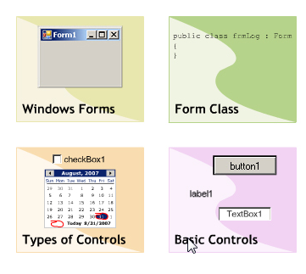
Objectives
Overview Window Form and basic Control
Form class
Type of Control
Basic Control
Summary

Slide 4
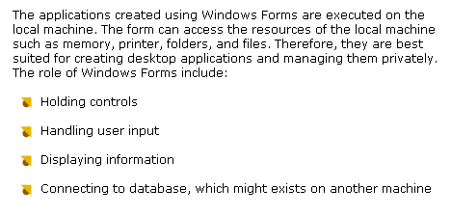
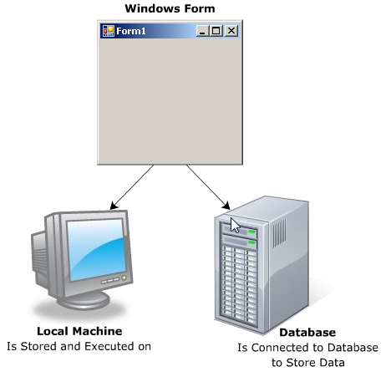
Windows Form

Slide 5
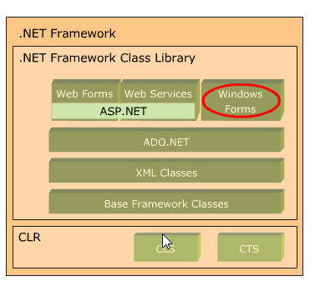
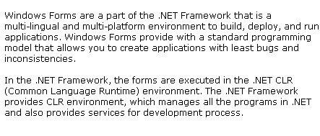
WinForms and .NET Framework

Slide 6
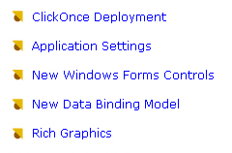
Features
Create App with leats operation
Store global data to reused anywhere
ToolStrip,MenuStrip ….
Powerfull way to link control with data source ( BindingSource component)
GDI+ : drawing and painting image on forms

Slide 7

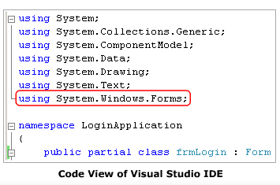
Form : basic unit of Application

Slide 8
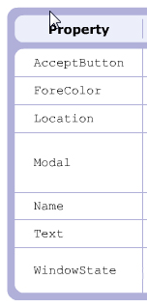
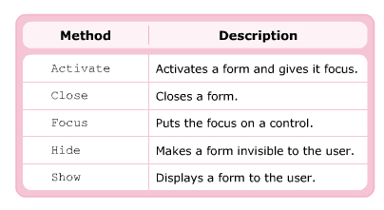
Form : property & method

Slide 9

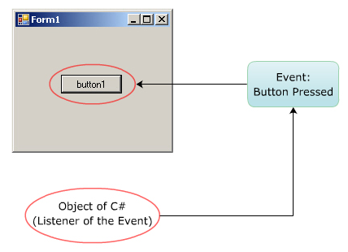
Events

Slide 10
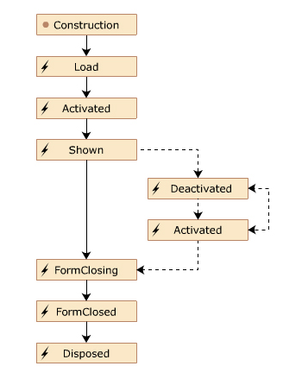
Life cycle of a form
Event
Activated
Click
Deactivated
FormClosed
FormClosing
GotFocus
Load
Resize

Slide 11
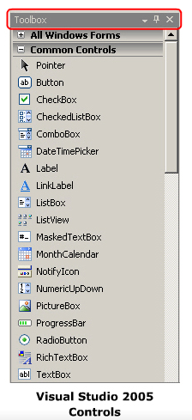
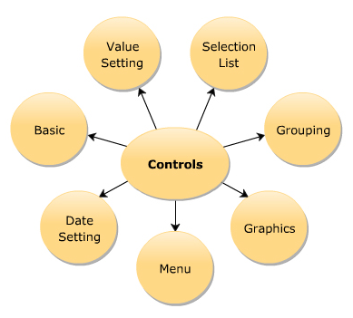
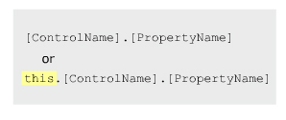
Use of Controls
Control class
Base class of all controls available in WinForms

Slide 12
Control Class – Properties-Method
Properties
Method
Event
canFocus
Controls
Enable
Name
Parent
TabIndex
Visible
Focus
getNextControl
Hide
IsMNemonic
Select
Show
Click
ControlAdd
DoubleClick
Validating
Validated
KeyPress
Leave
LostFocus
MouseClick
Move

Slide 13
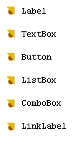
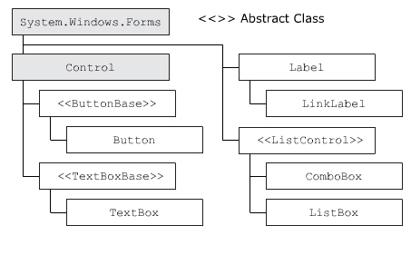
Common Controls

Slide 14
Label class : Property – Method- Event
Properties
Method
Event
Name
Text
TextAlign
UseMnemonic
Contains
Hide
Show
Click
Label fname = new Label();
fname.Text = “&First Name : “;
fname.UseMnemonic = true ;

Slide 15
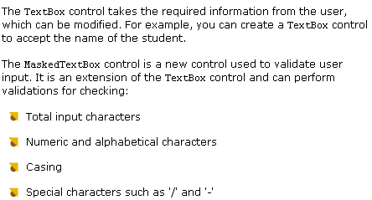
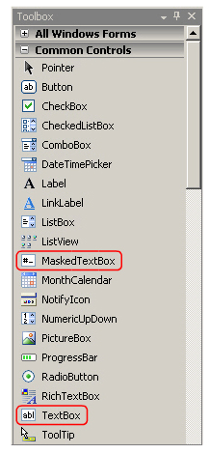
TextBox & MaskedTextBox

Slide 16
TextBox class : Property – Method- Event
Properties
Method
Event
CharacterCasing
MaxLength
MultiLine
Name
PasswordChar
ReadOnly
Text
AppendText
Clear
Focus
Copy
Paste
KeyPress
Leave
TextChanged

Slide 17
DEMO
Create windows form application
Use datagridview , listview to display data
Handle textbox & button events
QA

Slide 18


